Slide 1
SOFTWARE ENGINEERING PROJECT DOCUMENTATION
መቀነት
Mekenet
hold your money together
Turns mobile-money SMS into a daily money record — automatically.
TEAM · CLASSROOM R3004
Lewi Kibru (Lead) | Lombame Lemma | Helen Tesfaye | Mekdes Tesfaye | Kenawak Berhanu

Slide 2



OUR VISION
Why This Matters
Financial literacy and digitalization for every small business — starting with the shop next door.
Financial Literacy
Digital by Default
Trust First
Numbers every owner can understand — no jargon.
Modern tools built for everyday shops, not enterprises.
Adoption starts with confidence, not compliance.
02

Slide 3


OVERVIEW
Introduction
Turns mobile-money SMS into a daily money record — automatically.
Reads SMS automatically
Turns telebirr alerts into transactions.
Built for Addis Ababa shop owners who can't see real profit or who owes them.
Works without internet
Offline-first; syncs on your terms.
Trust matters more than tracking — many owners fear digital records.
Plain-language insights
“You made X birr this week.”
03

Slide 4
GOALS
Objectives
GENERAL OBJECTIVE
Build a trust-first app that turns SMS into a daily money record — automatically.
SPECIFIC OBJECTIVES
1
Auto-parse telebirr SMS
2
Offline-first daily record
3
Plain-language insights
4
Manual debt tracking
5
Full user control over data
6
Bank-ready export reports
05

Slide 5

THE CHALLENGE
Statement of the Problem
Owners get paid via telebirr, CBE Birr, and cash — but can't see real profit or who owes them.
telebirr
CBE Birr
Result: bad restocking, overspending, and trouble getting loans.
cash
Three channels in, no clear picture out.
THE GAP
Shop owners need a trusted, low-friction way to see their money clearly — without fear.
04

Slide 6


WHAT IT DOES
Key Features
Automatic SMS Parsing
No manual entry, ever.
Offline-First Record
Works anywhere, syncs on demand.
Plain-Language Insights
Clear numbers, no jargon.
Who-Owes-Me List
The one manual feature, by design.
User-Controlled Export
You choose when to share.
06

Slide 7

WHO USES IT
System Actors
Shop Owner
Bank / Loan Officer
Primary user of the app
External recipient, not a user
Register & set PIN
Receives report only when sent
View daily profit
Reviews clean history
Review SMS transactions
Track who owes you
No direct data access
Add expenses manually
Control cloud sync
No admin role by design — the owner stays in control.
Export bank report
07

Slide 8
SCOPE BOUNDARIES
Limitations
Android only — pilot phase
Telebirr only, no CBE Birr
No inventory or forecasting
Debts tracked manually
Needs SMS + internet access
08

Slide 9
HOW IT'S BUILT
Methodology — Eight-Day Build Order
Two weeks cut to eight days by narrowing scope, not adding hands.
1
Foundations
5
Core UI
DB + repo skeleton
Profit view, debts, quick-tap
2
Parser Built
6
Full Integration
Tested on real SMS
Live offline test
3
Core Loop Live
7
Sync + Export
SMS → saved transaction
Cloud sync, privacy proof
4
Local DB + Matcher
8
Accuracy + Demo
Real DB, manual expense
Final numbers, rehearsal
Day 3 is the make-or-break milestone.
09

Slide 10

WHAT THE SYSTEM SHALL DO
Functional Requirements
Auto-parse SMS
Store data offline
Sync on demand
Plain-language insights
Manual debt entries
Manual expense entries
PIN-secured access
Export loan-ready report
10

Slide 11




QUALITY ATTRIBUTES
Non-Functional Requirements
Performance
Security
Reliability
Fast on any Android phone
PIN + encrypted storage
Fully usable offline
Privacy
Usability
Maintainability
You control what's shared
No financial jargon
Modular, easy to extend
11

Slide 12


QUALITY ASSURANCE
Testing & Evaluation
TESTING METHODS
EVALUATION CRITERIA
Unit Testing
Parsing Accuracy
Real SMS samples
Honest % on real data
Integration Testing
Offline Reliability
App + backend together
Proven live on demo day
Offline-Mode Testing
Onboarding Clarity
No network required
Clear permissions & PIN
Corpus Accuracy
Demo Readiness
Measured, not assumed
Full rehearsal, real device
12

Slide 13
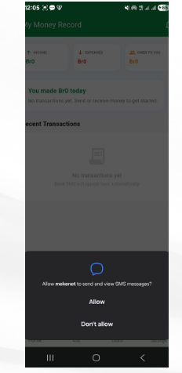
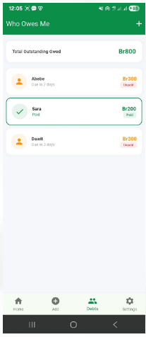
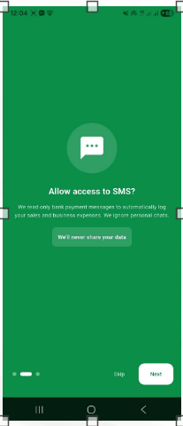
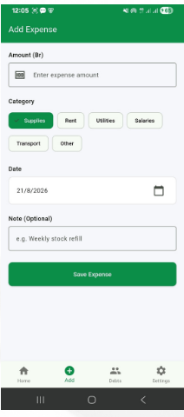
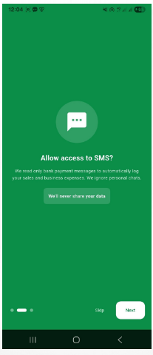
USER INTERFACE
UI Flow
Home Overview
Who Owes Me
SMS Access
Add Expense
SMS Access
13

Slide 14
DATA MODEL
Class Diagram (Simplified)
User
Transaction
PriceMatchRule
Item
1:n
n:1
userId
nameA
phone
pinHasha
transactionId
amount
sender
type
timestamp
ruleId
itemId
priceRange
confidence
itemId
name
avgPrice
m:n
+updatePrice()
+register()
+setupPin()
+matchTransaction()
+parseFromSMS()
+save()
1:n
Debt
debtId
personName
amount
dateAdded
+markSettled()
User → Transaction & Debt (1:n). PriceMatchRule links a Transaction to a learned Item (n:1).
14

Slide 15



UNDER THE HOOD
Technologies Used
APP
BACKEND
DATABASE
AUTH & STORAGE
VERSION CONTROL
Flutter (Dart)
Android (pilot)
Python
FastAPI
PostgreSQL
Encrypted SQLite
Device PIN
sqflite_sqlcipher
Git
GitHub
15

Slide 16
EXPERIENCE
User Interface & Unique Features
INTERFACE PAGES
UNIQUE FEATURES
Trust-First Onboarding
Nothing to type, ever
Home / Profit View
Manual debts, kept honest
Quick-Tap Picker
You choose what to share
Who-Owes-Me (Debts)
Insights, not statements
Export & Report Screen
Built for offline life
16

Slide 17


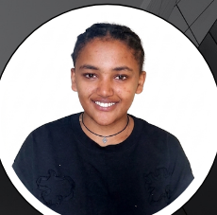


MEET OUR
team members
LEWI KIBRU
LOMBAMME LEMMA
HELEN TESFAYE
KENAWAK BERHANU
MEKDES TESFAYE
CTC-6064-26
CTC-888-26
CTC-1586-26
CTC-6591-26
CTC-1711-26
Lead · Backend & Database
Backend & Data Services
SMS Integration & Storage
Transaction Parsing & Matching
Frontend UI/UX
17

Slide 18
CONCLUSION
Money records shop owners can trust
A daily money record shop owners can trust — automatic, offline-first, and always in their control.
Clean bookkeeping today. A bank-ready report tomorrow.
Practical and buildable in eight days — trust-first mobile development.

Slide 19
WITH GRATITUDE
Thank You
For your time, attention, and trust in this project.
Mekenet — hold your money together.
TEAM CTC-2026 · Lewi Kibru | Lombame Lemma | Helen Tesfaye | Mekdes Tesfaye | Kenawak Berhanu

